Slide 1





Exploring Permission Induced Risk in Android
VISVESVARAYA TECHNOLOGICAL UNIVERSITY
“JNANA SANGAMA”, BELAGAVI-590018.
Technical Seminar
on
SEMINAR BY
GAURAV SHARMA [1JB15CS051]
UNDER THE GUIDANCE OF
Mrs. Nirmala H
ASSOCIATE PROFESSOR,
Dept. of CSE, SJBIT
SJB INSTITUTE OF TECHNOLOGY
Kengeri, Bengaluru- 560060
2018 - 2019

Slide 2
Contents
Introduction
Literature Survey
Problem Statement
System Design
Implementation
Experimental design
Performance Analysis
Conclusion
References

Slide 3
Introduction
SMARTPHONES and mobile devices have become explosively popular for personal or business use in recent years.
Meantime, smartphone platforms have seen a massive surge in malwares
With Android accounting for 81 percent of all smartphone shipments globally
The volume of Android malware families and samples has been growing explosively
As the official application (or app) market, Google’s Play store provides a platform of delivering apps for Android smartphones and mobile devices.
There are many third-party app markets providing similar platforms
App developers publish their apps on the Google’s play or on the third-party app markets, where end users download and install their interested apps on their Android smartphones

Slide 4
Obviously, how to detect and keep the large number of malware out of the application (or app) markets is an emerging, crucial, but challenging issue
Previous work on the detection of malapps mainly focused on permissions , static and dynamic analysis .
Permission control is one of the major Android security mechanisms
Android permissions provide fine-grained security features by enforcing restrictions on the specific operations that a particular process can perform
Android provides developers documentation, but its permission information is limited
The lack of reliable permission information may let developers request unnecessary permissions, resulting in overprivileged applications [19] that users may cancel the installation.
The lack of risk information of permissions confuses the users with regard to determining whether to install the app or not
It is feasible to identify malapps through analyzing the permission usage patterns, as intuitively an app’s behavior is characterized by the permissions it requests.

Slide 5
Literature Survey
Most recent studies reported in literature use sophisticated Machine Learning Techniques to classify mall apps such as :
1)Support Vector Machines(SVMs)
[ M. V. Albert, K. Kording, M. Herrmann, and A. Jayaraman, “Fall classification by machine learning using mobile phones,” PloS one, vol. 7, no. 5, p. e36556, 2012. ]
2)Android Permissions
W. Enck, D. Octeau, P. McDaniel, and S. Chaudhuri, “A study of Android application security,” in Proc. 20th USENIX Secur. Symp., 2011

Slide 6
Problem statement
Android has been a major target of malicious applications (malapps). How to detect and keep the malapps out of the app markets is an ongoing challenge.
One of the central design points of Android security mechanism is permission control that restricts the access of apps to core facilities of devices. However, it imparts a significant responsibility to the app developers with regard to accurately specifying the requested permissions and to the users with regard to fully understanding the risk of granting certain combinations of permissions. Android permissions requested by an app depict the app’s behavioural patterns

Slide 7
System Design
Android Security Mechanism:
Apps are Sandboxed from each other.
Each Android app is assigned a unique User ID(UID).
The permissions requests are given in Android.Manisfest.xml file of app.
To use the app the user has to give that permission.
The user need to understand the risk of giving permissions.
The permission should be given as least priviledged.
Permission can be classified as normal or dangerous.

Slide 8

Experimental Design
Data set Benign apps and malapps
Steps:
1)Evaluate the risk of granting individual permission
2)Evaluate the risk of granting collaboration of permission
3)Build a classifier to classify malapps.
4)Use the classifier to report the malapps

Slide 9
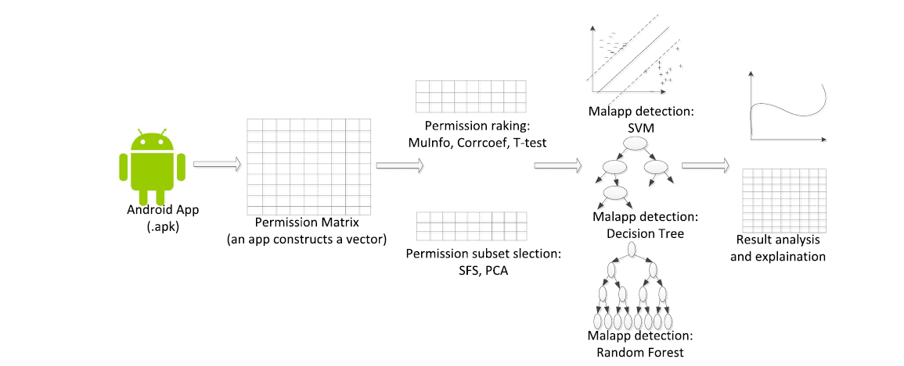
Methods and process for exploring permission-reduced risks and the detection of malicious applications in three levels.

Slide 10


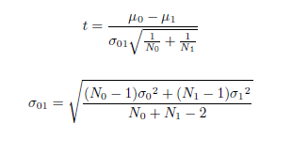
1)Ranking permission w.r.t risk:
a)Mutual information:
b)Pearson CorrCoeff:
c)T-Test:

Slide 11
2)Identifying Risky permission set:
To identify risky permission set we employ:
1)Sequential Forward Selection(SFS):
It is greedy algorithm.
It sequentially add features to an empty candidate until the addition of further feature cannot improve prediction.
2)Prinicipal Component Analysis(PCA):
It construct new features by applying either linear or non-linear functions on the original features.
New feature can reveal latent variables that better classify relationships
It is a method for representing original data by new-defined variables.

Slide 12
3)Building Detectors of Malapps:
To build a detector ,three machine learning algorithms are employed:
a)Support Vector machine(SVM):
It seeks the best hyperplane that seperates data objects from one class on one side ,while others on the other side.
Margin separating hyperplane is formulated by quadratic programming.
b)Decision Tree(DTree):
The nodes in decision trees represents permissions or features
It is used for classification.
c)Random Forest:
It is an ensemble of decision trees.
The final decision of classification is made by voting among all learned trees

Slide 13
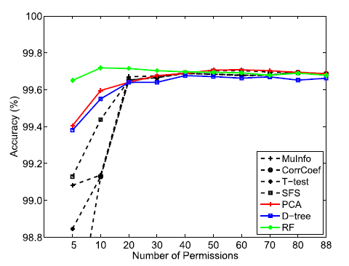
Performance Analysis
The detection accuracy of 7 different methods when increasing the
number of permissions.

Slide 14
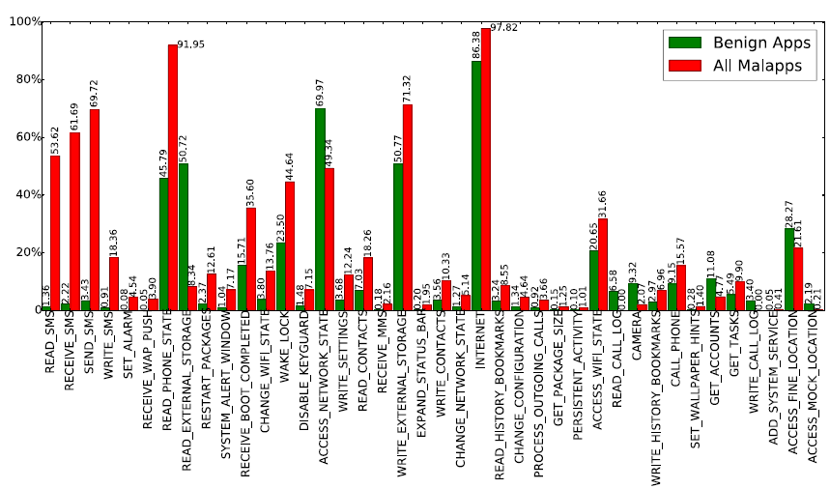
Occurrence percentage of top 40 ranked risky permissions (with CorrCoef) in benign apps and malapps

Slide 15
Conclusion
In this work, a systematic study on the exploration of permission-induced risk in Android apps on a large-scale in three levels.
Several algorithms, namely, SVM, Decision Tree and Random Forest, to detect malapps have been employed based on the identified subsets of risky permissions.
The empirical results show that with the 40 risky permissions, the best detection rate with Random Forest reaches 0.9462 at a false positive rate of 0.006

Slide 16
References
[1] H. Peng et al., “Using probabilistic generative models for ranking risks of Android apps,” in Proc. ACM Conf. CCS, 2012,
[2]B. P. Sarma, N. Li, C. Gates, R. Potharaju, C. Nita-Rotaru, and I. Molloy, “Android permissions: A perspective combining risks and benefits,” in Proc. 17th ACM SACMAT, 2012,
[3] W. Enck, D. Octeau, P. McDaniel, and S. Chaudhuri, “A study of Android application security,” in Proc. 20th USENIX Secur. Symp., 2011
[4] M. C. Grace, Y. Zhou, Q. Zhang, S. Zou, and X. Jiang, “RiskRanker: Scalable and accurate zero-day Android malware detection,” in Proc. 10th Int. Conf. MobiSys, 2012,

